Slide 1
Revision Record
Don’t Print This Page
COURSE CODE
PRODUCT
PRODUCT VERSION
COURSE VERSION
Installation
UAP3300
V100R001
1.01
DEVELOPER / MODIFIER
DATE
APPROVER
NEW / UPDATE
Nagaraj G
2011-10-05
NEW

Slide 2
UAP3300 Installation

Slide 3

Agenda
Installing the UAP3300 Hardware using the UAP Maintenance station
Monitoring UAP using the UAP Maintenance Station
References

Slide 4
Objectives
Upon completion of this course, you will be able to:
Install UAP3300
Configure the UAP3300 and its boards
Configure NFS server
Configure MRS boards
Configure SIP trunk
Monitor UAP3300 using Maintenance Station

Slide 5

Target Audience
This course has been designed for the audience who want to configure the UAP3300 system using MT Tool.

Slide 6
Training Pre Requisites
UAP Maintenance station Introduction
UAP Maintenance Station Server and Client Installation
UAP3300 Overview
UAP3300 Basics and its boards
NOTE: Refer to UAP maintenance station installation Presentation Path: 01.ISV Material\01. Domain\02. UAP\01. Training Material

Slide 7
Installation Pre-Requisites
IP Address Availability
Serial Port Connector
Desktop PC
LAN Switch
Obtain the License using the ESN of UAP3300

Slide 8
Agenda
Installing the UAP3300 Hardware using the UAP Maintenance station
Monitoring UAP using the UAP Maintenance Station
References

Slide 9

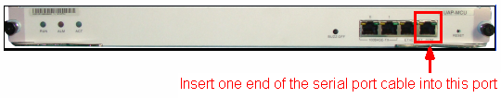
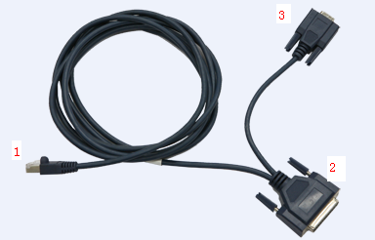
Installation of UAP3300 Using UAP Maintenance Station
Step 1: Obtain the UAP3300 version to be loaded, from support site of Huawei - UAP3300 V100R002C05SPC400 Host program.rar
Step 2: Create a directory in the desktop with name V100R002C05SPC400 and store the UAP software version.
Changing the Initial IP Address:
Step 1: Connect the serial Port Cable between UAP-MCU and local desktop PC (COM1 and COM2).
Notes:
Insert one end of the serial port cable (port 1 in Figure) into the commissioning serial port on the UAP MCU board, as shown in Figure.
Insert the other end of the serial port cable (port 2 in Figure) into either of the serial ports at the back of the PC. Two serial ports are marked as COM1 and COM2.

Slide 10
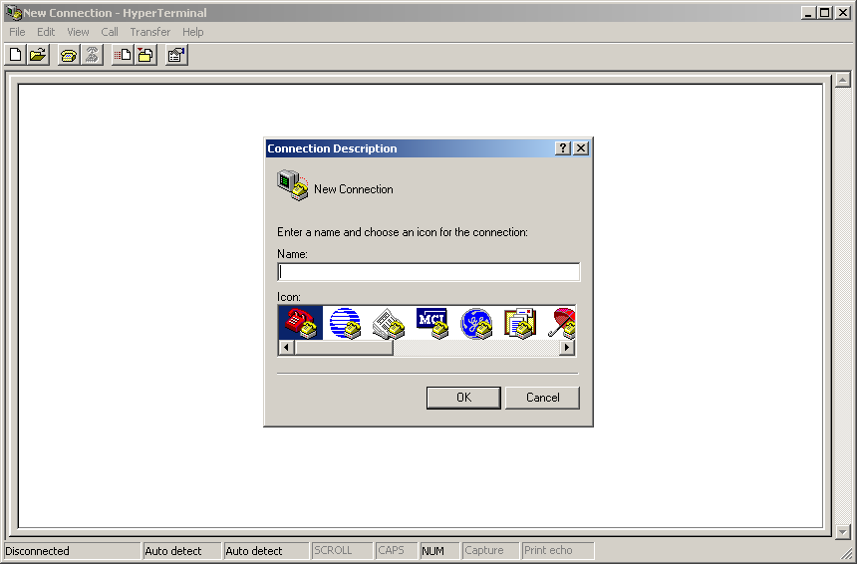
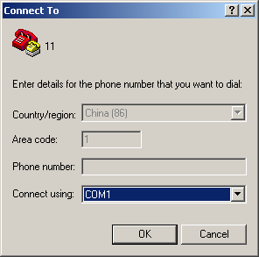
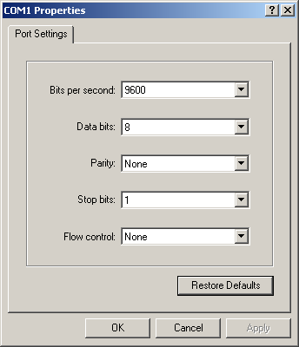
Installation of UAP3300 Using UAP Maintenance Station Contd.,
Step 2: Choose Start > Programs > Accessories > Communications > HyperTerminal
Hyper terminal connects the UAP3300 using the local desktop PC through the Serial port..
a
b
HyperTerminal Configuration steps:
Enter a connection name for identification e.g 11
Select a serial port from the Connecting using drop-down list box.
Set port attributes as displayed
c

Slide 11
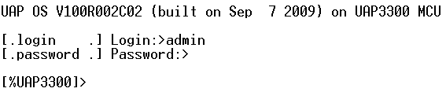
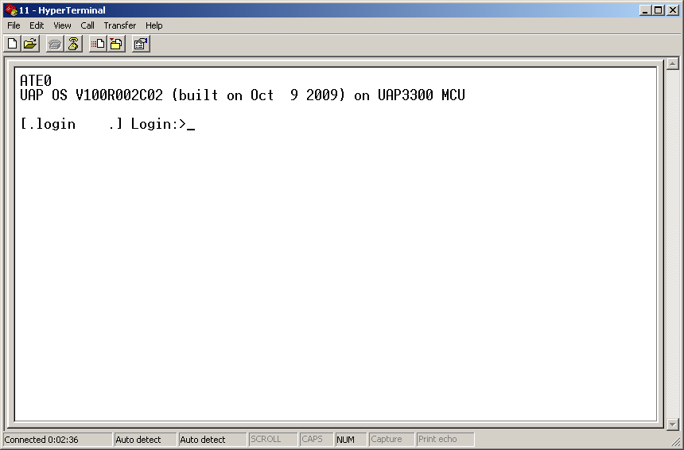
Installation of UAP3300 Using UAP Maintenance Station Contd.,
Step 3: Login to UAP3300 using the username and password. The initial user name is xxxxx and the password is xxxxxx

Slide 12
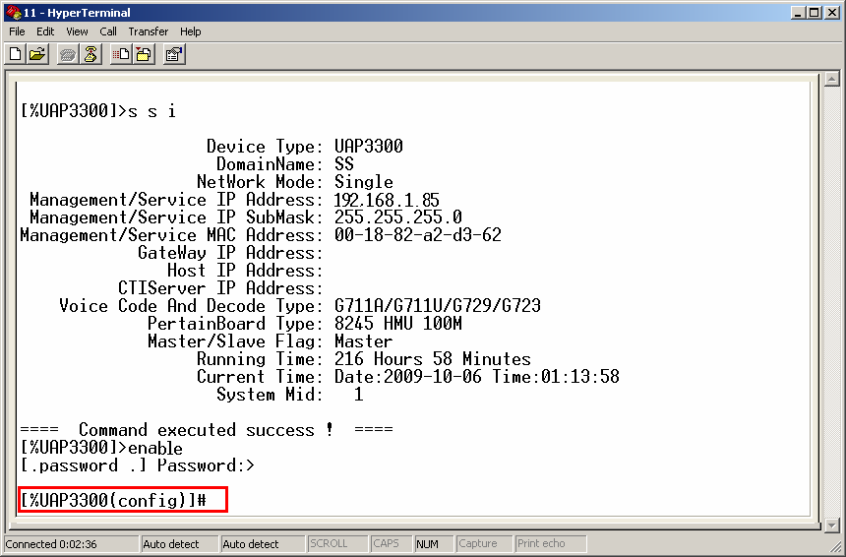
Installation of UAP3300 Using UAP Maintenance Station Contd.,
Step 4: Enter enable, press Enter, and then enter the password xxxxxx to switch to configuration mode and type system information, Press Enter
Step 5: Run the following commands to set the UAP IP Address, Gateway IP Address, domain Name etc..,

Slide 13
Installation of UAP3300 Using UAP Maintenance Station Contd.,
config system ip < A.B.C.D >
config system gateway ip < A.B.C.D >
config system domainname <string>
Run the save command to save the modification.
[%UAP3300(config)]# save
[%UAP3300(config)]# show system information.
The modifications done will be visible. Now reboot the UAP using the command reboot. When the system reboots the modifications will take the effect.
[%UAP3300(config)]# reboot
Notes:
Domain name is a name added to the UAP to identify it.
Gateway IP Indicates the gateway IP address of the UAP

Slide 14
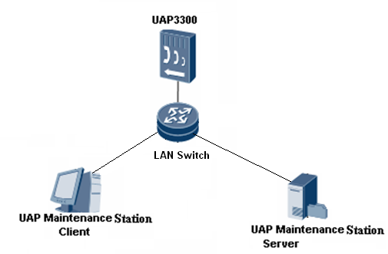
Installation of UAP3300 Using UAP Maintenance Station Contd.,
Connect the UAP3300, UAP maintenance station server and client in the network using the LAN switch as shown in the below figure to start installation and basic configuration of UAP

Slide 15
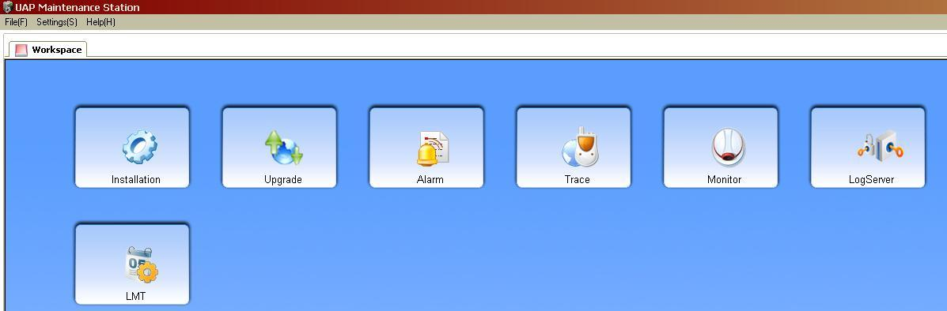
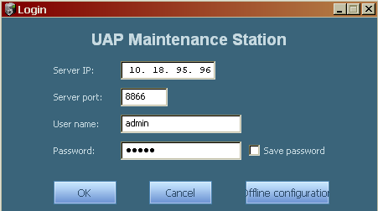
Installation of UAP3300 Using UAP Maintenance Station Contd.,
Step 6: Start the UAP Maintenance Server and Client.
Select on the Installation Icon.
Step 7: Enter the Server IP adrs
and password is xxxxx
Select Ok
Notes:
The MTTool server IP needs to be entered here.

Slide 16
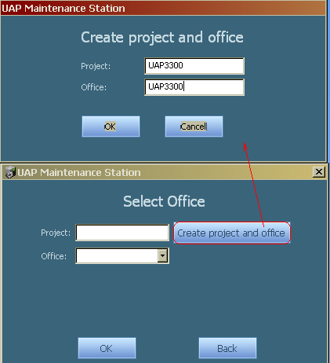
Installation of UAP3300 Using UAP Maintenance Station Contd.,
Step 8: Select on the create project and office. Enter Project and Office details and select Ok
In the main window select Ok
Notes:
Project and Office:
It is a logical separation/differentiation of Offices/Local Exchanges.
Eg: New York is one local Office, Los Angeles can be another local office with UAP3300 respectively.
Admins can login to their respective local office and do upgradation, rollback etc.,

Slide 17
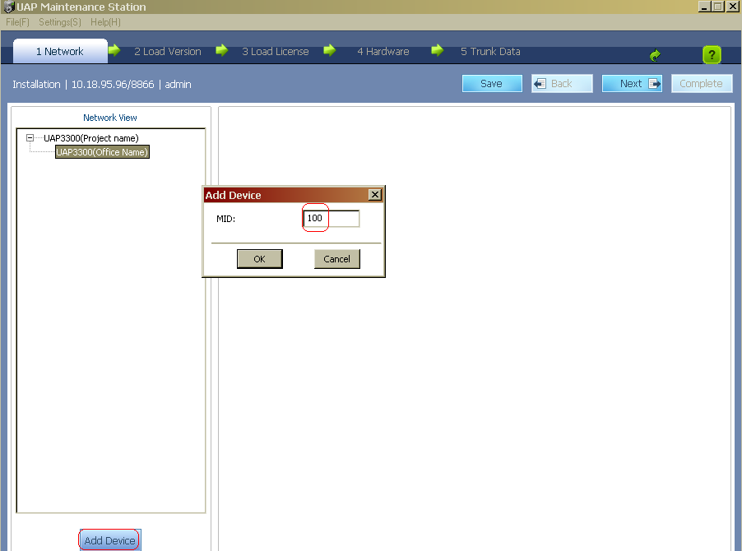
Installation of UAP3300 Using UAP Maintenance Station Contd.,
Step 9: Add Device and enter the mid of UAP

Slide 18
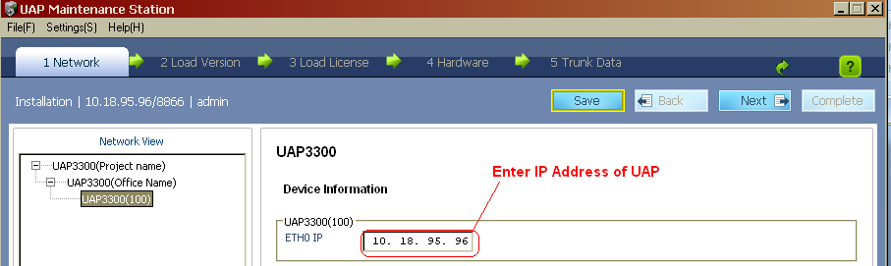
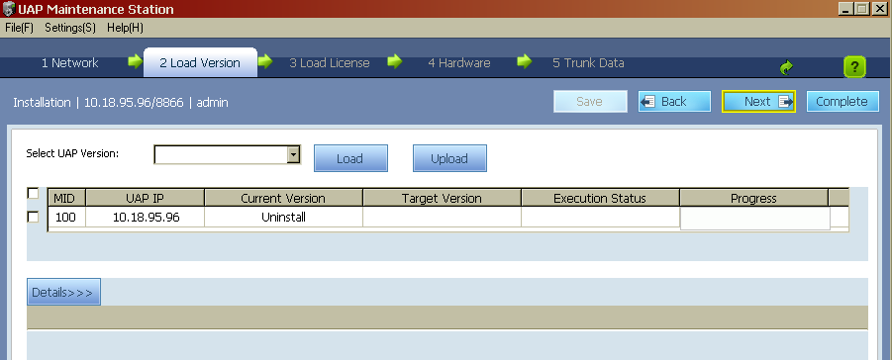
Installation of UAP3300 Using UAP Maintenance Station Contd.,
Step 10: Select Next

Slide 19
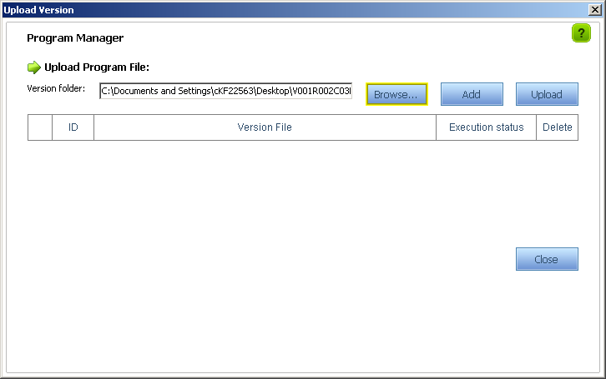
Installation of UAP3300 Using UAP Maintenance Station Contd.,
Step 11: Click Upload Program. The system displays the page for uploading the version. Click Browse Select, and then select the path where the saved version is located in the file browse window
Click Add to create the version upload information.
Click Upload to upload the version. The upload progress bar is displayed during the uploading.
After the version is uploaded successfully, Click Ok
Click Close to close the page for uploading the version, and return to the page for loading the version.
Notes:
Note: Final folder name should match with the selected version name in MT Tool.

Slide 20
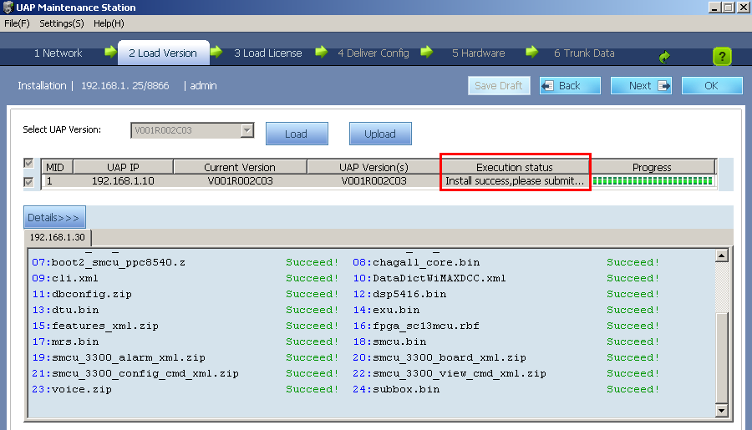
Installation of UAP3300 Using UAP Maintenance Station Contd.,
Loading software Version to UAP
Step 12: Select the UAP to load the version.
Step 13: Select the version number from the Select Version to be loaded drop-down list box
Step 14: Click Load. The system displays a dialog box

Slide 21
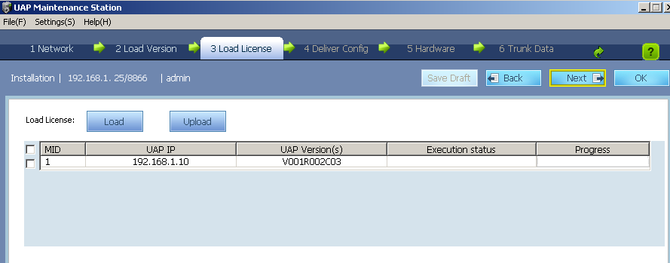
Installation of UAP3300 Using UAP Maintenance Station Contd.,
Step 15: After the software version is loaded, click Next to access the page
for loading the license
Click Upload, and then select the license file on the displayed page.
Set the project, office, and UAP device, to which the license file is uploaded.
Click Browse Select, and then select the path where the saved license file is located in the file browse window.
Click Add to create the license upload information.
5. Click Upload to upload the license. Once license is uploaded, Say Ok.

Slide 22
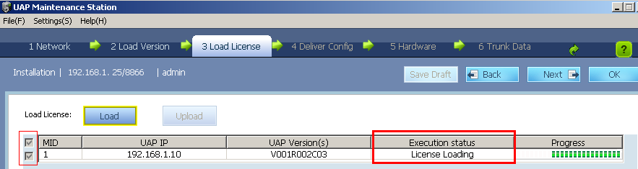
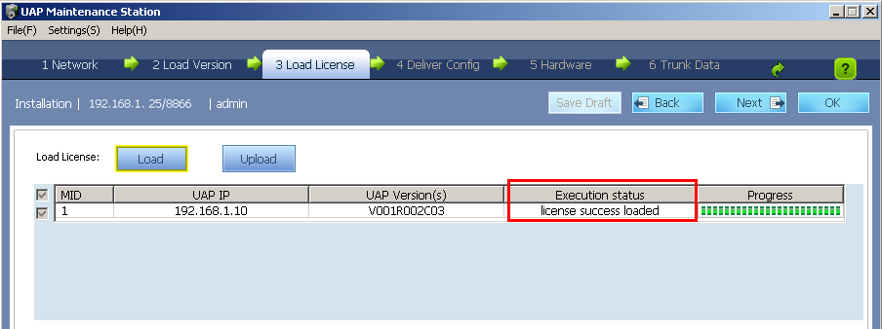
Installation of UAP3300 Using UAP Maintenance Station Contd.,
Step 16: Load the License to UAP
Select the UAP to which the license needs to be loaded from the UAP list.
Click Load. The system starts to load the license file
3. After the license is loaded, the system displays the message indicating successful loading

Slide 23
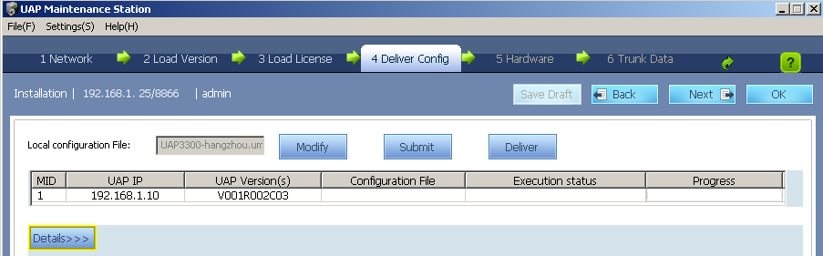
Installation of UAP3300 Using UAP Maintenance Station Contd.,
Step 17: Configuring the Basic Data of the UAP
Step 1: After the license is loaded, click Next to access the page for delivering the configuration data

Slide 24
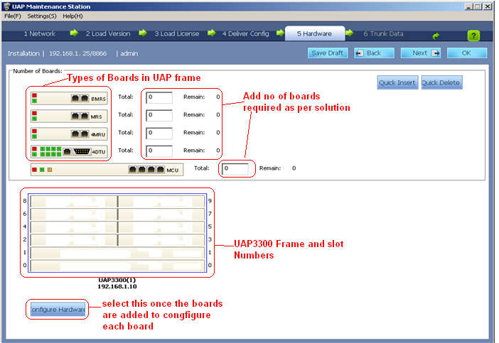
Installation of UAP3300 Using UAP Maintenance Station Contd.,
Step 2: Select modify button to access the configuration Page.

Slide 25
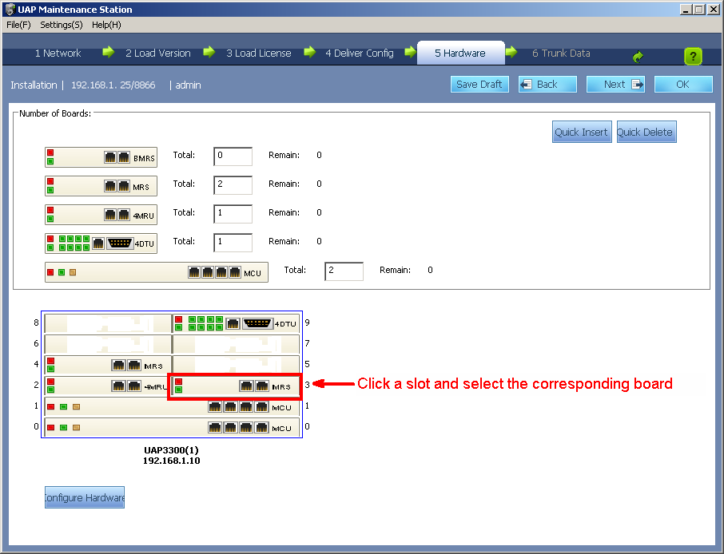
Installation of UAP3300 Using UAP Maintenance Station Contd.,
Step 3: Set the number of boards and the slot numbers according to the planning.
Click a slot and select the corresponding board type from the drop-down list box, as shown in Figure

Slide 26
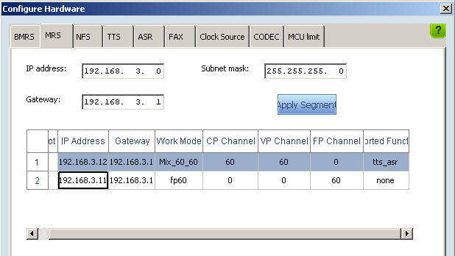
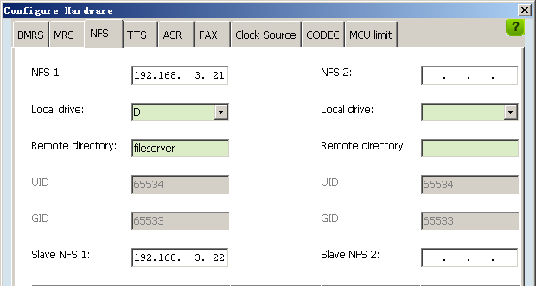
Installation of UAP3300 Using UAP Maintenance Station Contd.,
Step 4: Click Configure Hardware to configure the relevant hardware data of the UAP. Click the MRS tab to set the IP address, gateway IP address, and working mode of the MRS
Step 5: Click the NFS tab to configure the detailed information about the NFS board. Set the parameters according to the planning

Slide 27

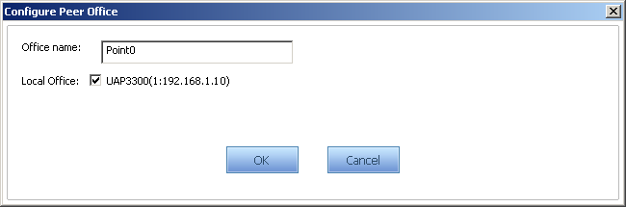
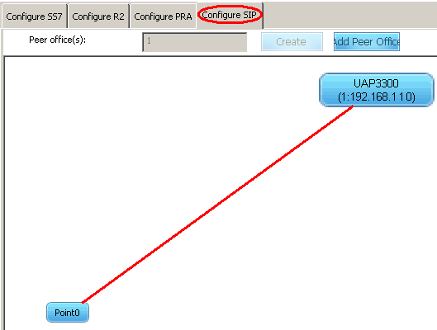
Installation of UAP3300 Using UAP Maintenance Station Contd.,
Step 18: Configuring the Trunk Data of the UAP
1: On the Trunk Data page, click Configure SIP and enter the number of peer offices.
2: Select Create.
Add point 0
3: Double-click the Point0 icon and configure the connection information
4: Select the local office device connected to the peer office device and click OK. A red line between the local office device icon and the peer office device icon is generated

Slide 28
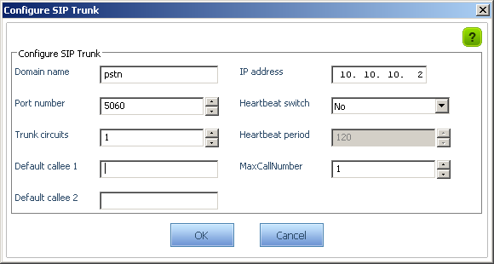
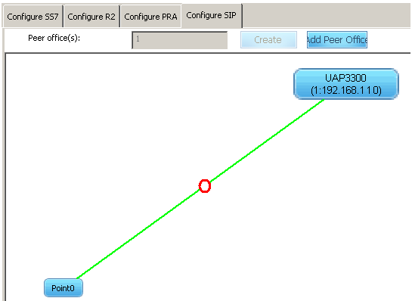
Installation of UAP3300 Using UAP Maintenance Station Contd.,
5: Double-click the red line and configure the SIP trunk according to the planning in the displayed Configure SIP Trunk dialog box
6: Click OK. The red line becomes green and a red circle is generated in the middle of the green line.

Slide 29
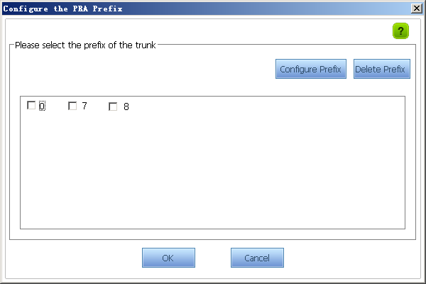
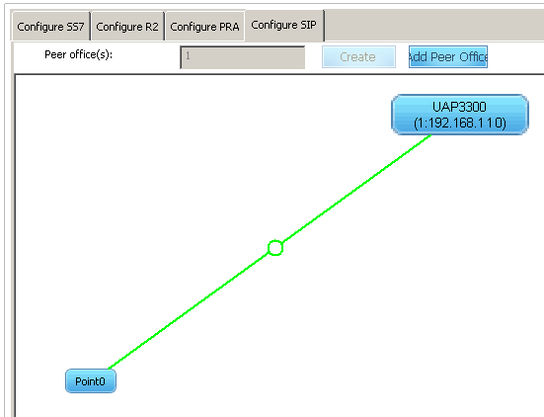
Installation of UAP3300 Using UAP Maintenance Station Contd.,
7: Double-click the red circle. The Configure SIP Prefix page is displayed, To configure the prefix select configure Prefix and select the prefix and say OK
8: Once the Prefix is configure, the RED Circle turns to GREEN

Slide 30
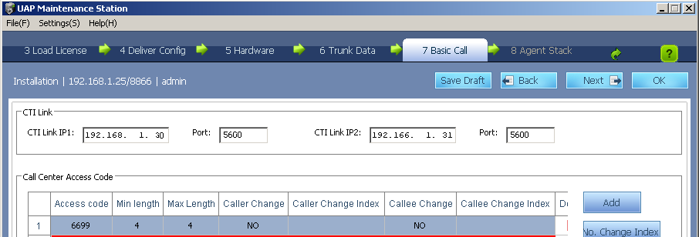
Installation of UAP3300 Using UAP Maintenance Station Contd.,
Step 19: Configure the basic call data
1: Enter the CTI Link IP and Port number
2: Click Add and add the Access Code (eg: 10086)
3: Select Next

Slide 31
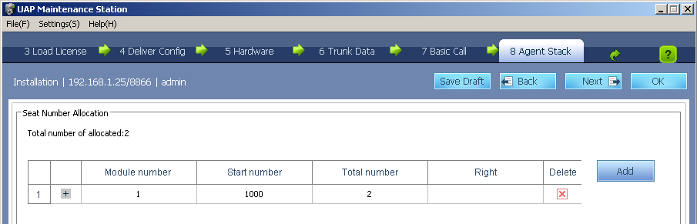
Installation of UAP3300 Using UAP Maintenance Station Contd.,
Step 20: Configure the Agent Phone Numbers in UAP
Step 1: Select Add and enter the module IP of UAP
Step 2: Add the start number of Agent Phone and no of phone count
Step 3: Select NEXT

Slide 32
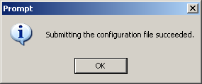
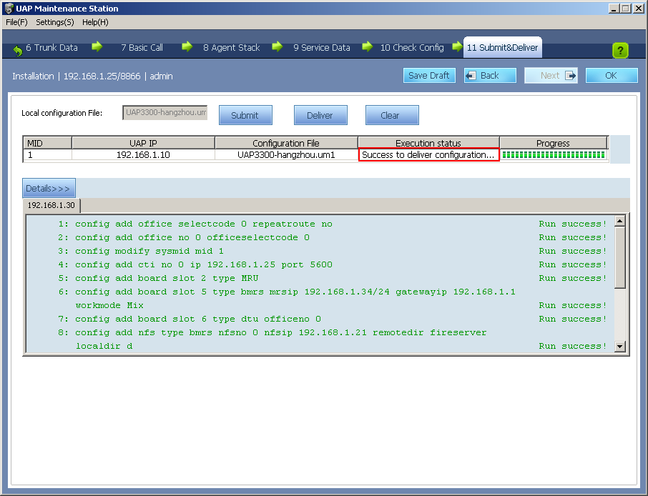
Installation of UAP3300 Using UAP Maintenance Station
Step 20: Submitting and delivering the configuration
1: Submit to synchronize the configuration result to the server
2: After the configuration file is submitted successful, the system displays a message
3: Click Deliver. The system displays a message indicating whether to deliver the configuration result. Click OK

Slide 33
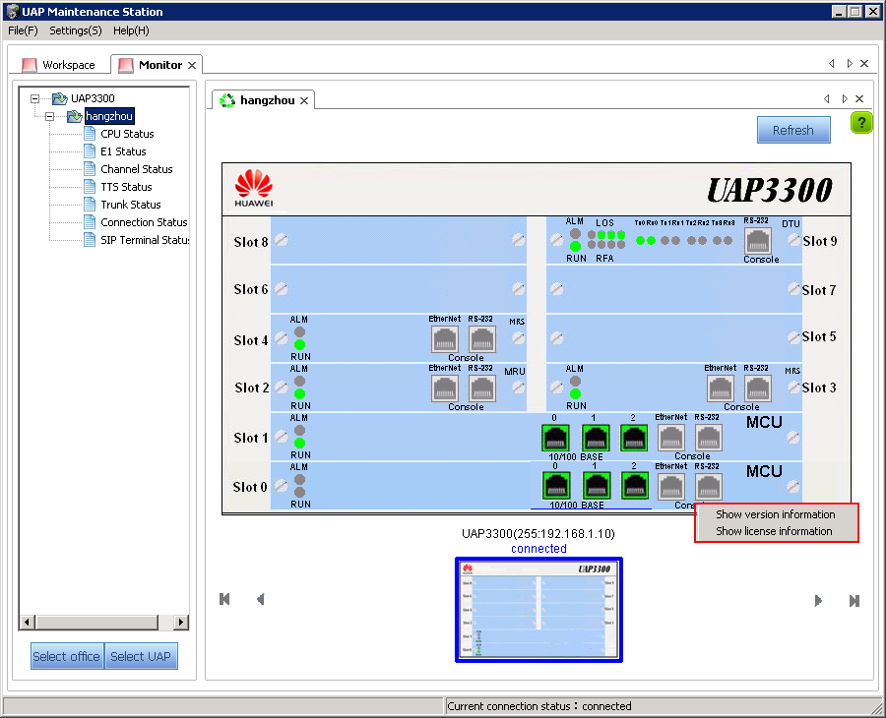
Monitoring the UAP using the Maintenance station
From Slide 14, select the monitor option from the Client window to monitor the status of the UAP and its boards, CPU Status, connection status, MRS boards channel status and trunk status and SIP Subscribers status.
Notes:
The configurations made till this step will be reflected in the monitoring window.

Slide 34
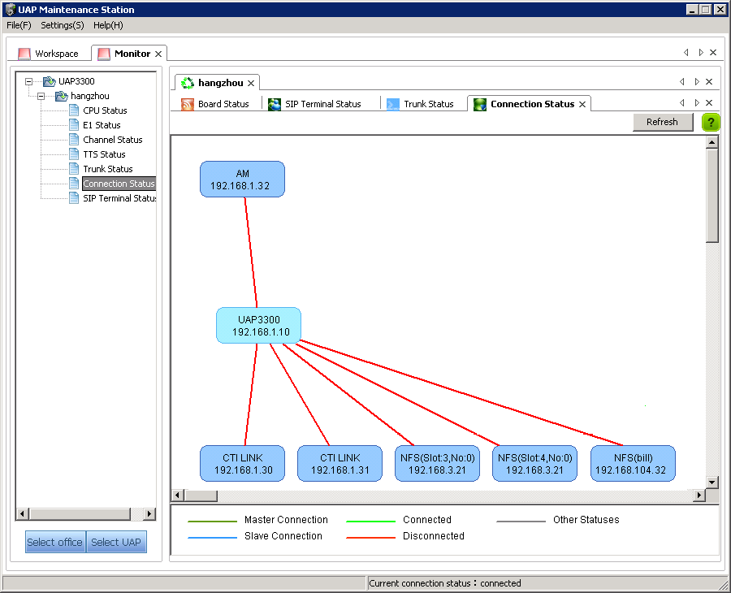
Monitoring the UAP using the Maintenance station
Notes:
The legends display the status of component selected.

Slide 35
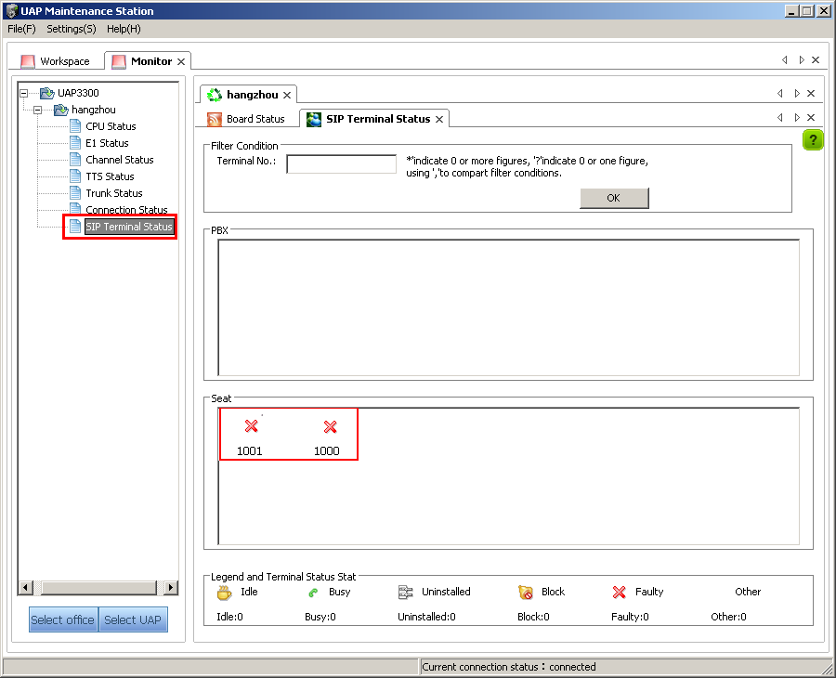
Monitoring the UAP using the Maintenance station

Slide 36
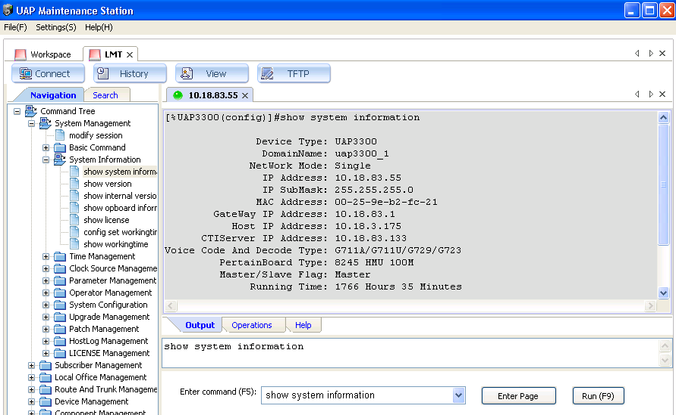
Commands Execution Using MT Tool
Step 1: Select the LMT option from the UAP Maintenance Station Client.
Step 2: Select the UAP / enter the UAP IP Address
Step 3: Interface for entering the commands and execution is displayed. This Interface can also be used for execution of the commands of UAP3300 apart from directly telnet the UAP IP and executing the commands

Slide 37
References
1. Reference Document for configuring the PRA Trunk, SS7 Trunk and other related information.
Refer to UAP3300 V100R002C03SPC400 Deployment Guide http://support.huawei.com/support/DocView.do?doc_id=SE0000465851&doc_type=VersionDoc
2. Trouble shooting Guide for UAP3300
Refer UAP3300 Maintenance Guide in UAP3300 V100R002C03SPC400 Product Manual
http://support.huawei.com/support/pages/kbcenter/view/product.do?actionFlag=detailProductSimple&web_doc_id=SE0000465852&doc_type=VersionDoc

